Slide 1
TUN PRESENTATION
By: Massa,Jason,Ernest, Kwasi,Terence

Slide 2
Problem and Motivation
Question: Is there a way to tell what communication method (call, texting or email) is more successful with clients, either based on their success in job placement or some other outcome?

Slide 3
Approach
Matched the ID column in contacts to WhoID column in the sales activities sheet to the other excel sheets.
Aggregating the sales activity by each communication method for each whoid.
Joined the call, email, and text excel sheets together to see results.
Data on 132738 users
Took whether they were hired by using the active color blue
Once we created excel with call, email, text in hired we put it in tableau to see how successful people were in getting hired

Slide 4
Tools and Analytics
Excel
Tableau Prep
Tableau Desktop

Slide 5
Findings
Email was the highest method of communication Hired Heroes used to contact people, while call was next, and text was the lowest
Determine the success rate by dividing the number of hired vs not hired separated by each method of communication.
Email was the most frequent way of communication with a success rate of 69%.
Second most frequent communication method was calling, which held a success rate of 42%.
The least used method of communication was texting, which provided a success rate of 79%.

Slide 6
Suggestions
Our analytics team suggest that HIRE HEROES USA focus on communication with their users through texting.
In the past, communication by Email was the most frequently while texting was the least.
Communication method amounted to a total of 92,125 and 15,261 respectively
Texting should be used because of its success rate of 79%
By having increasing the number of users that were reached through text, if it sustained anywhere near its current success rate, then there will be a large number of successful candidates that have been hired.
Eliminates wasteful spending on communication.

Slide 7
Outside Research
Over 80% of American adults text, making it the most common cell phone activity. (Pew Internet)
Text messages have a 98% open rate, while email has only a 20% open rate. (Mobile Marketing Watch)
Text messaging has a 45% response rate, while email only has a 6% response rate. (Velocify)
90% of all text messages are read in under 3 minutes. (Connect Mogul)
96% of smartphone users text. (Acision)
On average, Americans exchange twice as many texts as they do calls (Nielsen)
Only 43% of smartphone owners use their phone to make calls, but over 70% of smartphone users text (Connect Mogul)
55% of heavy text message users (50+ texts per day) say they would prefer to receive a text over a phone call (Pew Research Center)
In 2011, 31% of Americans said they preferred text messages to phone calls (Pew Research Center)
It takes the average person 90 minutes to respond to email, but only 90 seconds to respond to a text message. (CTIA)

Slide 8
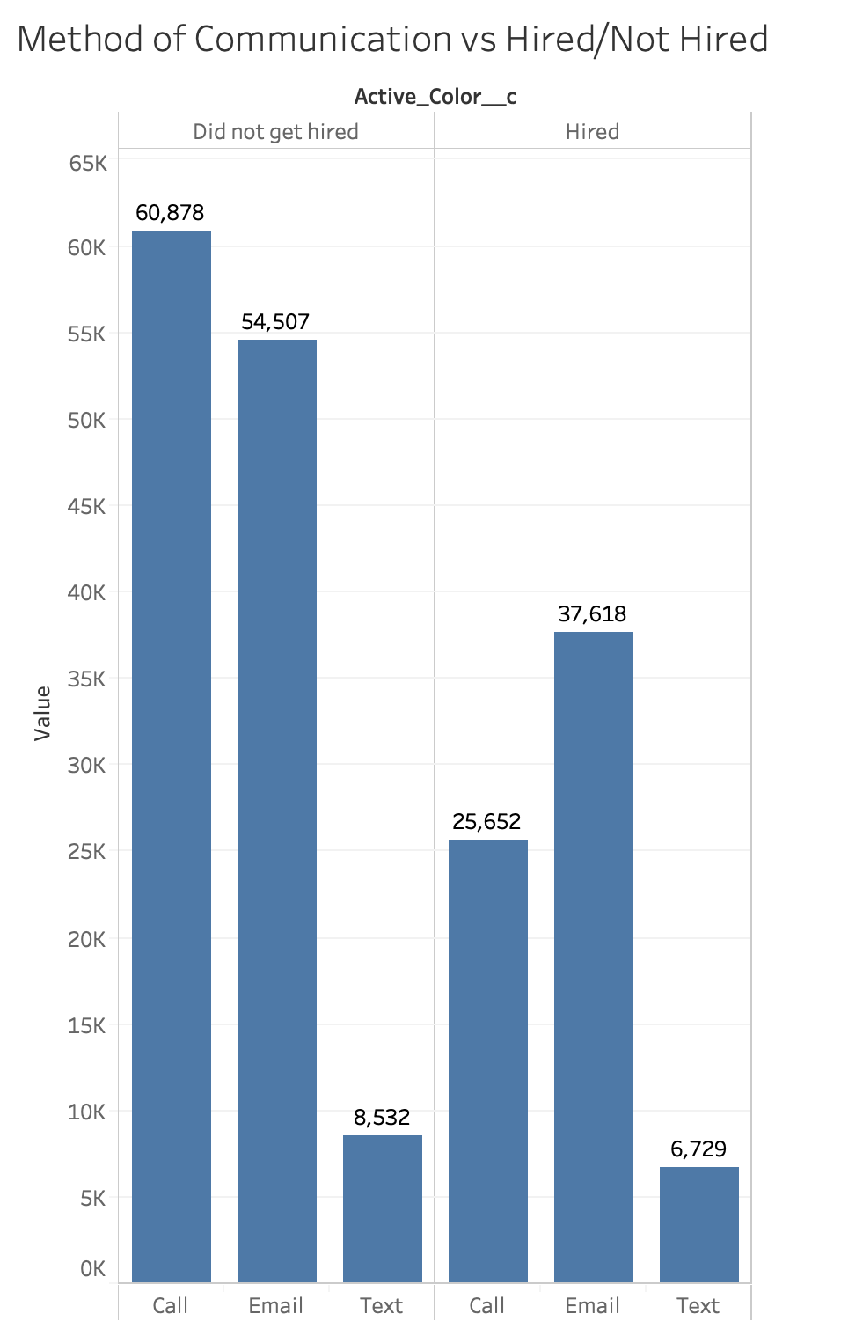
Results

Slide 9
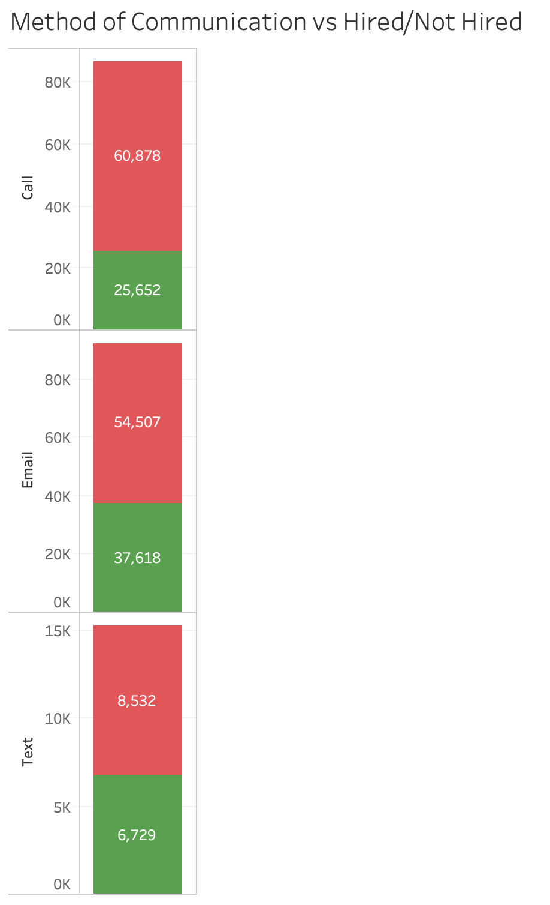
Results

